Slide 1
CONSUMER GOODS
ATLIQ HARDWARE
AD-HOC INSIGHTS

Slide 2
Atliq Hardwares is one of the leading computer hardware producers in India and well expanded in other countries too.

Slide 3
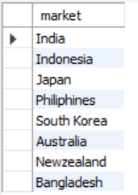
Market list for ‘Atliq Exclusive’ in APAC region
Question 1 :
Provide the list of markets in which customer "Atliq Exclusive" operates its business in the APAC region.
Output :

Slide 4

Conversion of Output to visual
3
5
1
8
2
4
India
Indonesia
Japan
Philiphines
South Korea
Australia
New Zealand
Bangladesh
6
7
Insights:
List of Markets in which Customer "Atliq Exclusive" operates its business in APAC region are India, Indonesia, Japan, Philiphines, South Korea, Australia, New Zealand and Bangladesh.

Slide 5
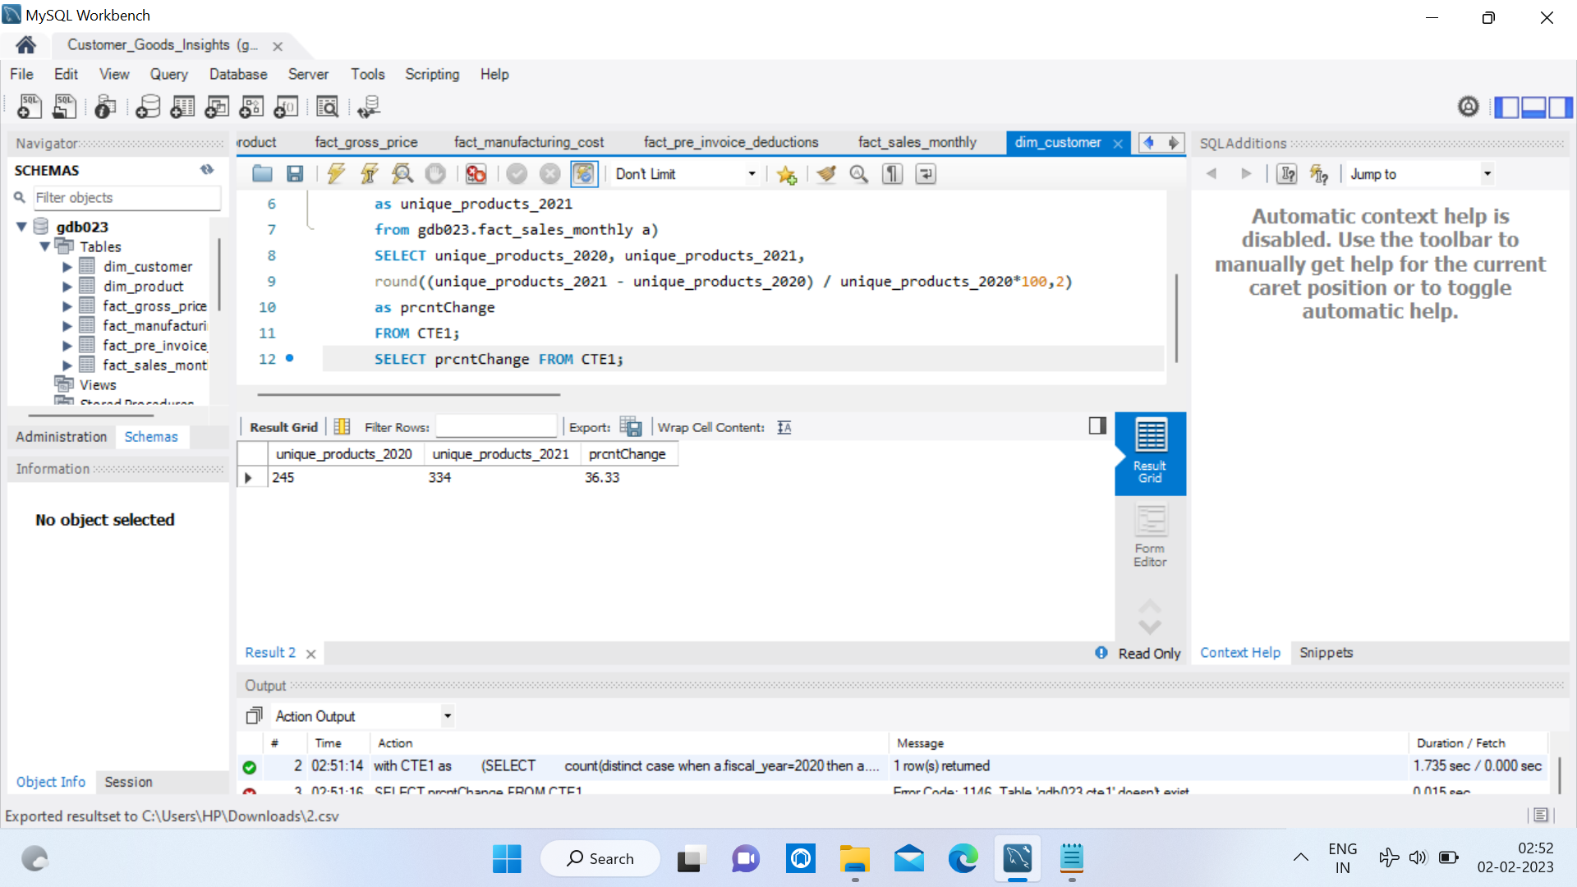
Increase in % of unique product
Question 2 :
What is the percentage of unique product increase in 2021 vs. 2020? The final output contains these fields,
unique_products_2020
unique_products_2021
percentage_chg
Output :

Slide 6
Conversion of Output to visual
Insights
Total Unique Product Count in 2020 is 245.
Total Unique Product Count in 2021 is 334.
Increase in % of Product Count is 36.33%.

Slide 7
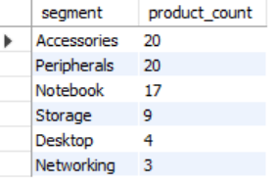
Increase in % of unique product
Question 3 :
Provide a report with all the unique product counts for each segment and sort
them in descending order of product counts.
The final output contains two fields,
segment
product_count
Output :

Slide 8
Conversion of Output to visual
Insights
In total we have 6 segments and Accessories and Peripherals hold the maximum unique product count

Slide 9
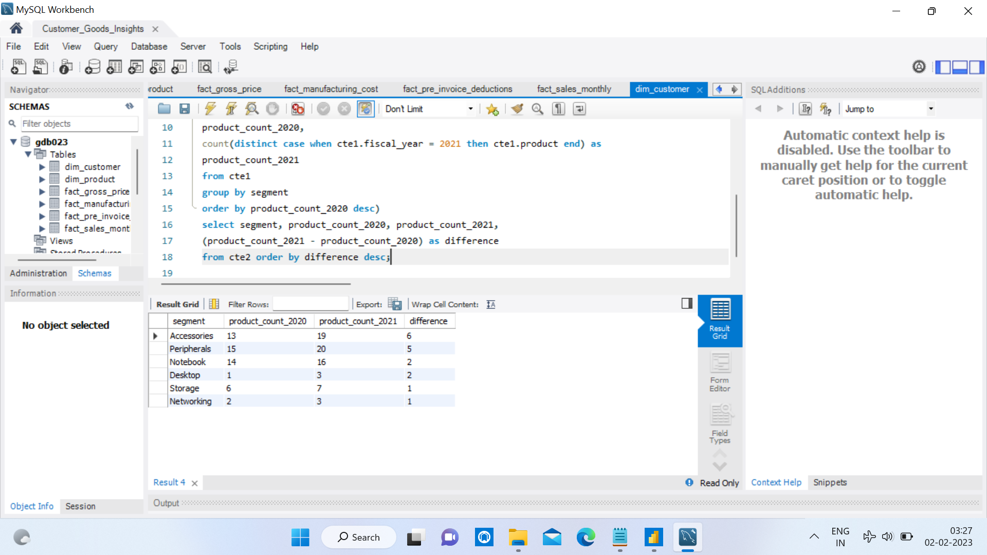
List of Product count by segment and by year
Question 4 :
Follow-up: Which segment had the most increase in unique products in 2021 vs
2020? The final output contains these fields,
segment
product_count_2020
product_count_2021
difference
Output :

Slide 10
Conversion of Output to visual
Insights
Accessories segment has the most increase in unique product in 2021 vs 2020.

Slide 11
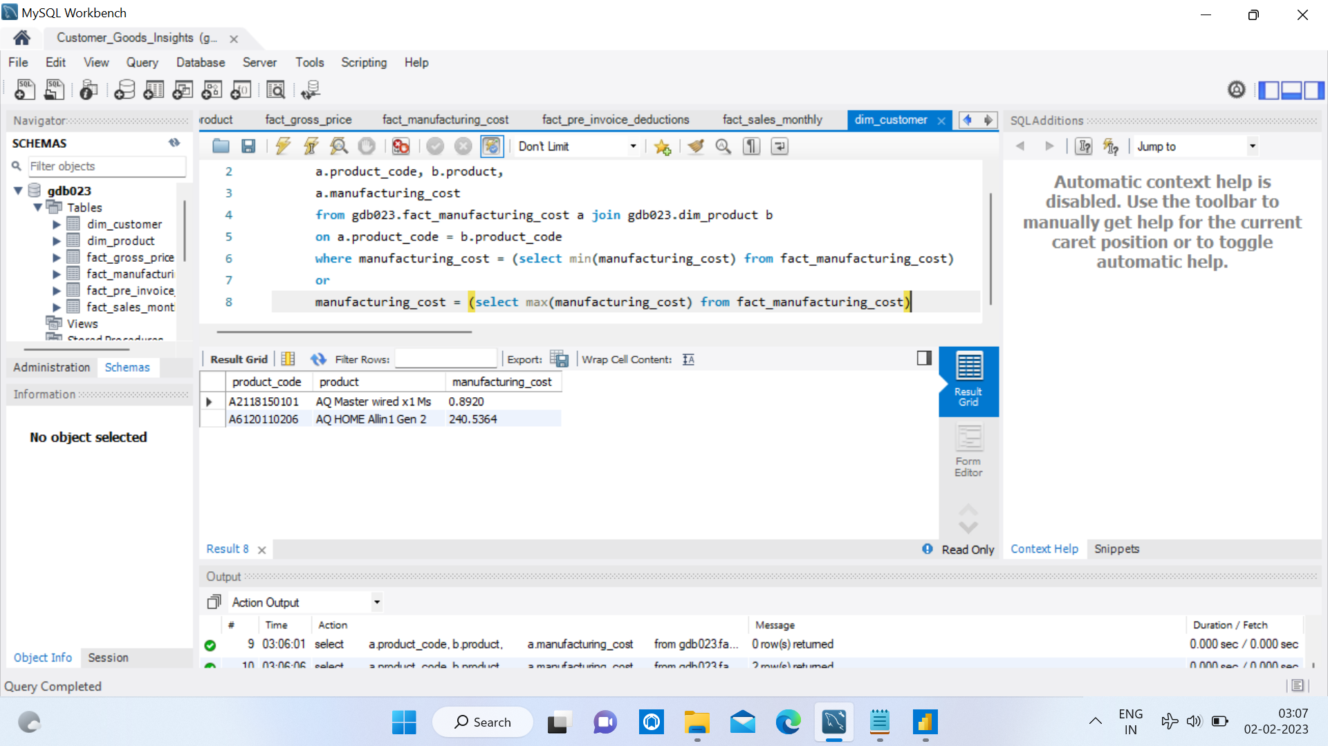
List of Product with Manufacturing Costs
Question 5 :
Get the products that have the highest and lowest manufacturing costs. The final
output should contain these fields,
product_code
product
manufacturing_cost
Output :

Slide 12
Conversion of Output to visual
Insights
‘AQ Master Wired x1 Ms’ has the highest manufacturing cost
while
‘AQ HOME Allin 1 Gen 2’ has the lowest manufacturing cost.

Slide 13
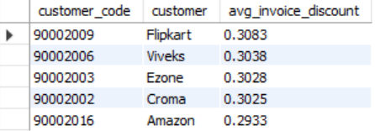
Report of customer with average pre_invoice discount
Question 6 :
Generate a report which contains the top 5 customers who received an average
high pre_invoice_discount_pct for the fiscal year 2021 and in the Indian market.
The final output contains these fields,
customer_code
customer
average_discount_percentage
Output :

Slide 14
Conversion of Output to visual
Insights
Top 5 customers who received an average
high ‘Pre Invoice Discount’ for the fiscal year 2021 and in the Indian market are: Flipkart, Viveks, Ezone, Croma, Amazon.

Slide 15
Report of Gross Sales for ‘Atliq Exclusive’ customer
Question 7 :
Get the complete report of the Gross sales amount for the customer “Atliq Exclusive” for each month. This analysis helps to get an idea of low and high-performing months and take strategic decisions. The final report contains these columns:
Month
Year
Gross sales Amount
Output :

Slide 16
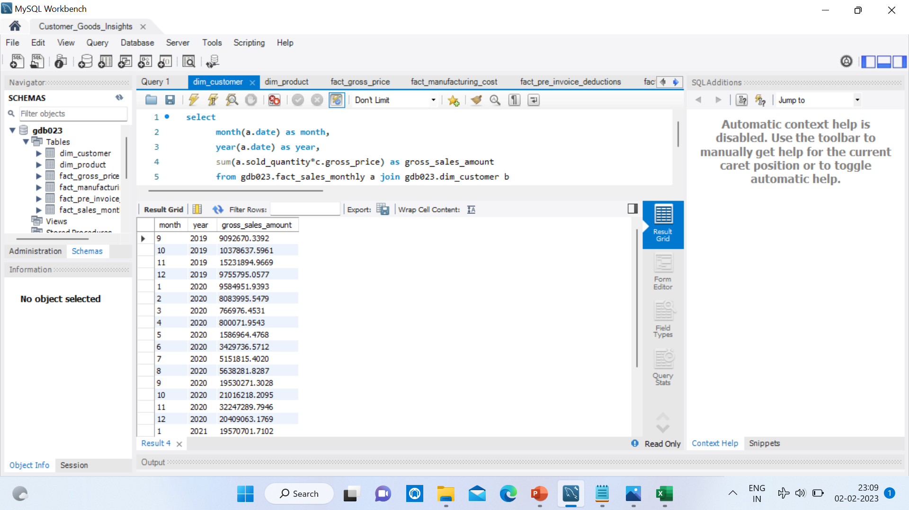
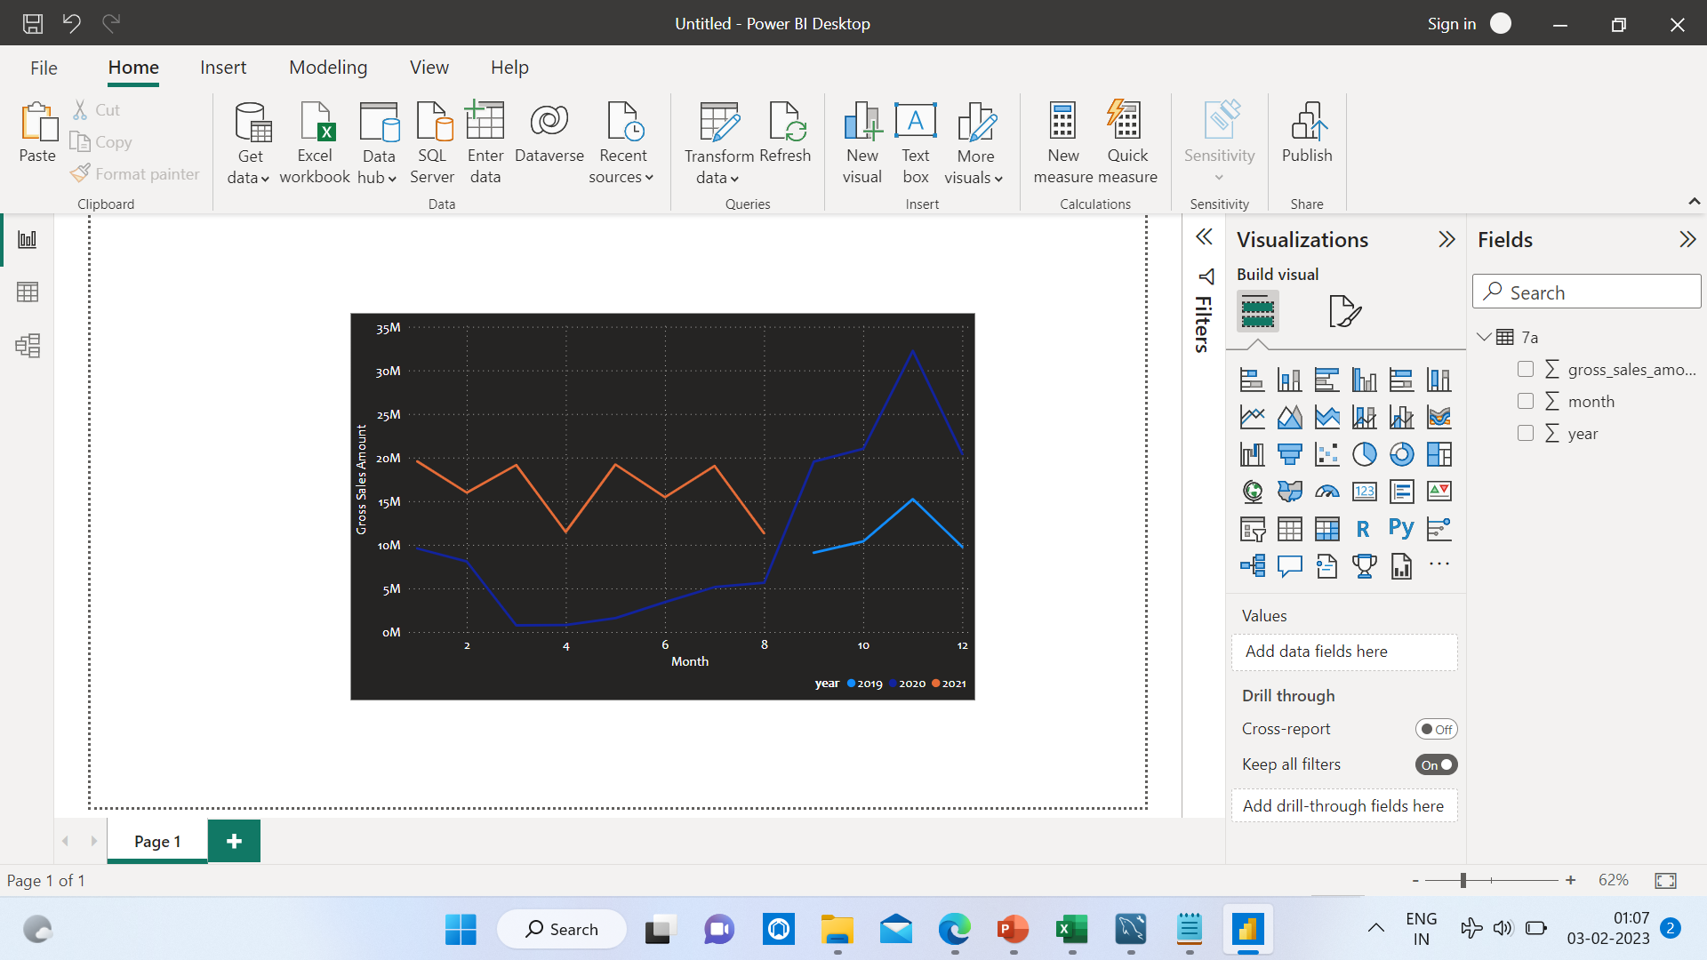
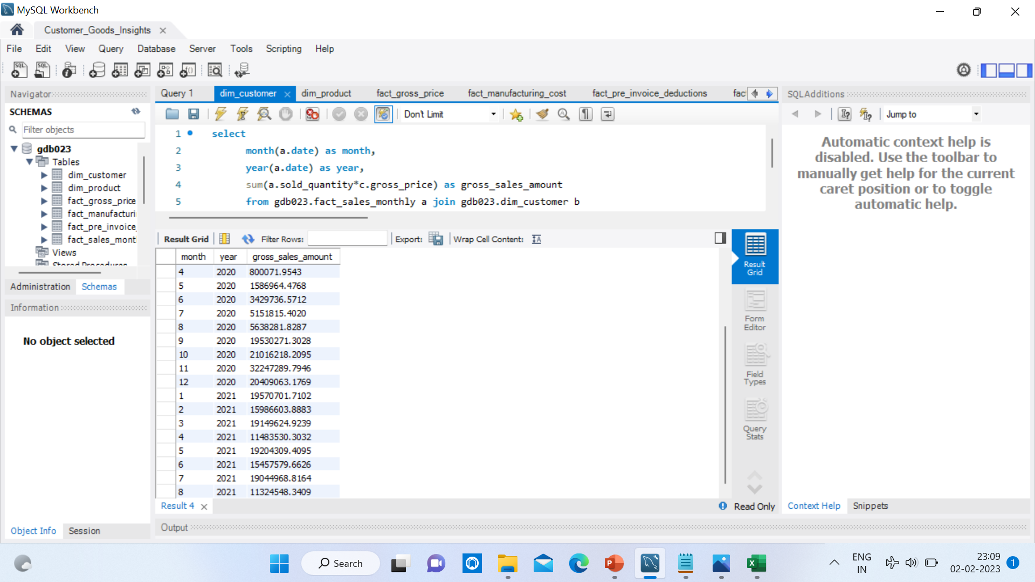
Conversion of Output to visual
Insights
Nov 2020 has the highest while March 2020 has the lowest Gross sales for the customer ‘Atliq Exclusive’.

Slide 17
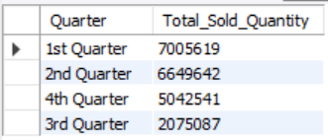
Total Sold quantity by Quarter of 2020
Question 8 :
In which quarter of 2020, got the maximum total_sold_quantity? The final output
contains these fields sorted by the total_sold_quantity,
Quarter
total_sold_quantity
Output :

Slide 18
Conversion of Output to visual
Insights
1st Quarter of 2020 i.e. {Sept, Oct, Nov} has the maximum Total Sold Quantity.

Slide 19
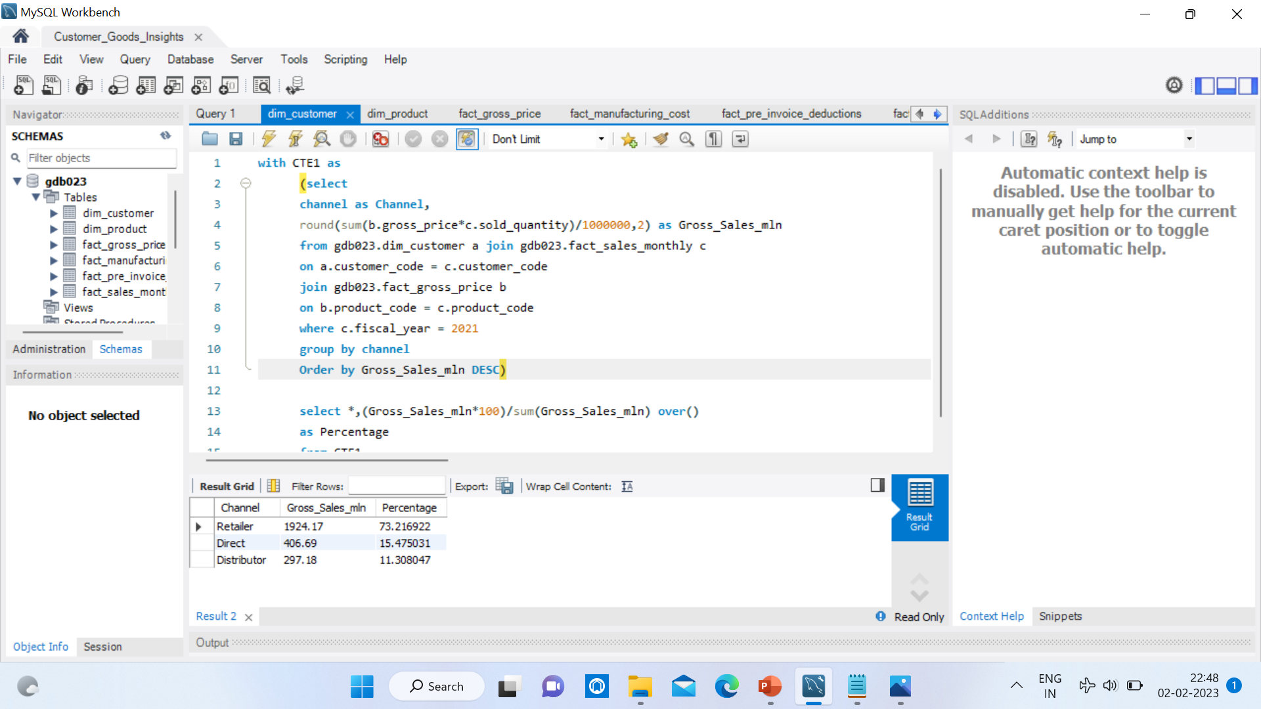
Report of Gross sales by Channel in 2021
Question 9 :
Which channel helped to bring more gross sales in the fiscal year 2021 and the
percentage of contribution? The final output contains these fields,
channel
gross_sales_mln
percentage
Output :

Slide 20
Conversion of Output to visual
Insights
Channel ‘Retailer’ helped to bring more Gross Sales in the fiscal year 2021 with the total of 73% contribution.

Slide 21
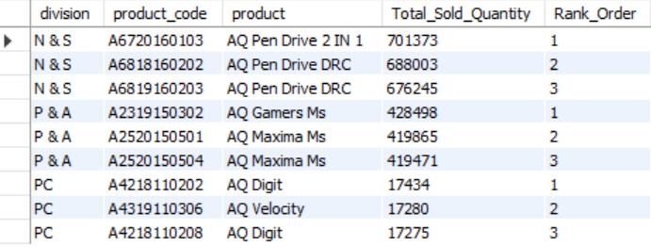
Top 3 products by division & sold quantity
Question 10 :
Get the Top 3 products in each division that have a high total_sold_quantity
in the fiscal_year 2021? The final output contains these fields,
division
product_code
product
total_sold_quantity
rank_order
Output :

Slide 22
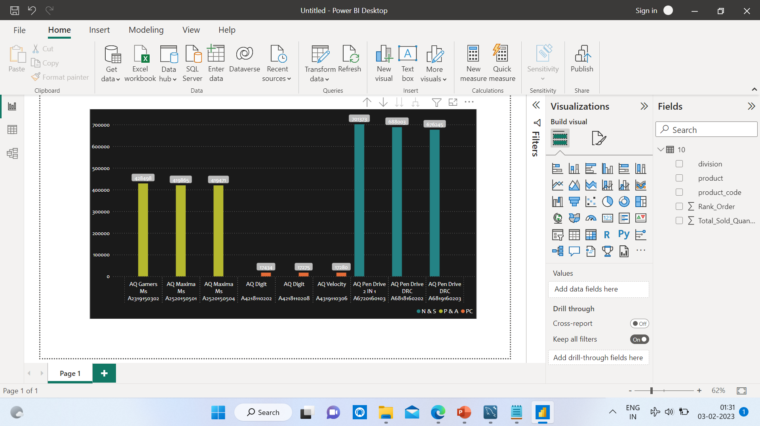
Conversion of Output to visual
Insights
Top 3 products in each division (N&S, P&A, PC) that have a high Total Sold Quantity in the Fiscal Year 2021 are shown in the chart.

Slide 23
THANK YOU

